Slide 1
UNIT 30 EXERCISE HEALTH & LIFESTYLE
LEARNING AIM C – PLAN & REVIEW LIFESTYLE PROGRAMMES

Slide 2
LEARNING AIM C
C1 – Plan a lifestyle programme for a selected individual.
C2 – Review the effectiveness of the individual’s lifestyle programme.

Slide 3
IN WHAT FORMAT COULD YOU PRESENT YOUR LIFESTYLE PLAN?
- Written Plan
- Electronical Document
- Spreadsheet
- Online Tools
- Personal Technology (Apps)

Slide 4
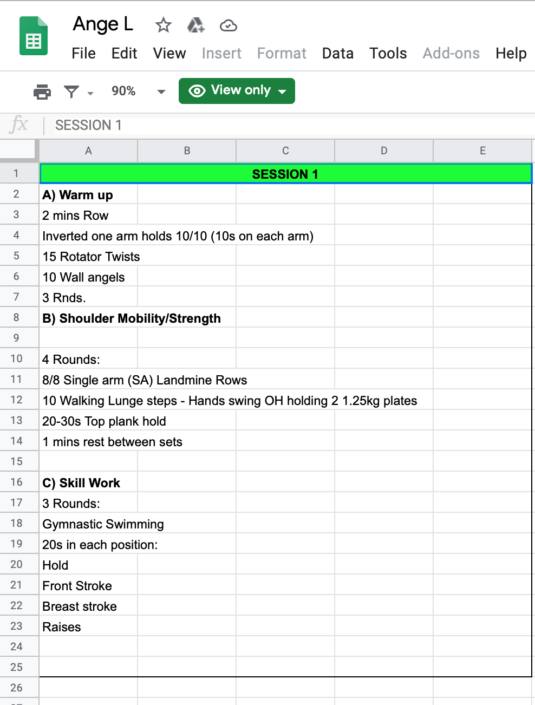
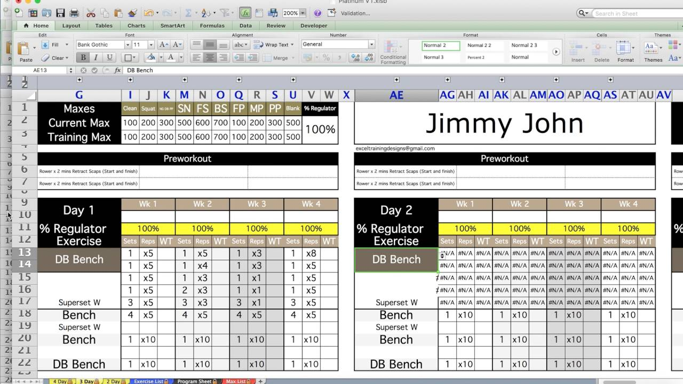
Written Format
Electronic
Spreadsheets

Slide 5
They are goals you want to accomplish soon.
A medium-term goal could be to run 10km
A goal that will take some significant time, effort and planning.
1 to 6-week time frame.
1- 6 months time frame.
They can take years to achieve.

Slide 6
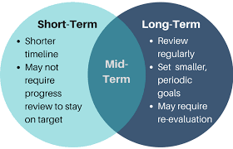

Slide 7
LIFESTYLE PROGRAMME
The lifestyle programme should include:
Physical activity factors
Mental-emotional factors
Social factors

Slide 8
EXAMPLES OF LIFESTYLE GOALS
Increase in physical activity levels
To participate in sporting activity
Join a sports club or an organisation
Change diet / eating habits
Take up a new hobby

Slide 9
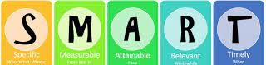
WHAT ARE YOU CLIENTS:
SHORT-TERM GOAL?
MEDIUM-TERM GOAL?
LONG-TERM GOAL?

Slide 10
WHAT TYPE OF ACTIVITIES WILL YOU INCLUDE?

Slide 11
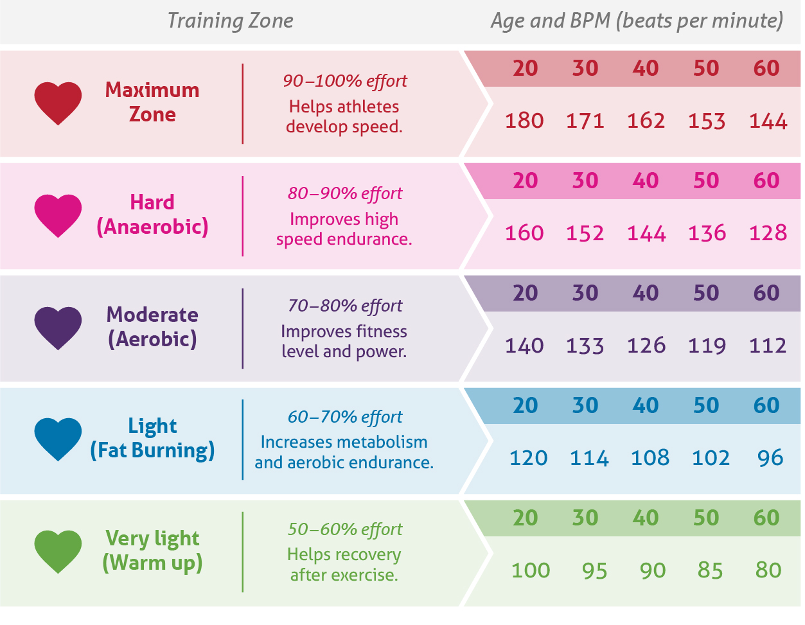
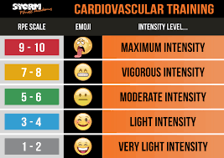
Heart Rate
(BPM)
RPE Scale
INTENSITY

Slide 12
LEARNING AIM C
C1 – Plan a lifestyle programme for a selected individual.
C2 – Review the effectiveness of the individual’s lifestyle programme.

Slide 13
EFFECTIVENESS OF THE PROGRAMME
You need to ensure that you review your programme, and your clients' progress regularly.
Include milestones (regular catch ups)
How will you do the review - face to face or online?
Consider the following during the catch ups...
Has the clients’ needs been met?
Does it meet the clients’ expectations?
How will you adapt the plan if needed?
ALWAYS HAVE A CONTINGENCY / BACK UP PLAN

Slide 14
P5
Produce a plan for a lifestyle programme for a selected individual, showing some detail and relevance
M3
Produce a well-detailed plan for a lifestyle programme for a selected individual, showing strong relevance.
D3
Produce a comprehensively relevant and highly detailed plan for a lifestyle programme for a selected individual, fully justify its effectiveness.
P6
Review the effectiveness of a lifestyle programme for the selected individual.
M4
Review the effectiveness of a lifestyle programme for the selected individual, with some justification for its effectiveness.
*6-WEEK PLAN*
*WRITTEN REPORT*

