Slide 1
learning objectives
Know what good health is
Be able to identify different components which may affect an individuals health
Understand how these different components can affect an individuals health

Slide 2
Define Health ……….

Slide 3
Health is “a state of complete physical, mental and social well being and not merely the absence of disease or infirmity”
Highlight in your books!

Slide 4
Health and well being triangle……
Physical
Can you think how each could effect our health?
1 min discussion, feedback
Mental
Social

Slide 5
Key terms…….
Physical health and well being.
All body systems working well, free from illness and injury. Ability to carry out everyday tasks.
Metal (emotional) health and well being.
Every individual realises his/her own potential, can cope with normal stresses of life, work productively and make a contribution to community.
Social health and well being:
Basic human needs are met (Food, shelter, clothing). The individual has friendship and support, value in society, has little stress in social circumstances.

Slide 6
In pairs put the statements under the correct heading.
Basic human need are met (Shelter, food, clothing)
Improve cardio-vascular system.
Provide friendship, support, value to society and socially active.
Provide a feeling that you can comfortably carry out activities and enjoy them.
Reduce stress/tension
Enable person to control emotions and work productively.
Improve heart function.
Reduce risk of illness (Diabetes)
Little stress suffered from social circumstances.
Help prevent obesity
Carry out everyday tasks with out getting tired.
Release feel-good hormones. (Seratonin)

Slide 7
PHYSICAL | MENTAL | SOCIAL
Improve heart function. Improve cardio-vascular system. Reduce risk of illness (Diabetes) Help prevent obesity Carry out everyday tasks with out getting tired. Provide a feeling that you can comfortably carry out activities and enjoy them. | Reduce stress/tension Release feel-good hormones. (Seratonin) Enable person to control emotions and work productively. | Basic human need are met (Shelter, food, clothing) Provide friendship, support, value to society and socially active. Little stress suffered from social circumstances. Affects of Phys. Act. Make friends Co-operation skills Team-work skills

Slide 8
Watch this clip
http://www.youtube.com/watch?v=yfshxvV5twc
What health benefits do you think the players are experiencing.

Slide 9
Exam question:
Explain how wearing a team strip helps your social health and wellbeing. (2 marks)
Answer:
Wearing a team strip provides not only clothing but also a sense of belonging; a team strip suggests friendship and support as well as some value in society.

Slide 10
Define fitness….
The ability to meet/cope with the demands of the environment.
Improvements in fitness will:
Improve the ability to cope with the demands
Reduce chance of suffering injuries
Make it easier to complete physical work
Make you more content/happy.

Slide 11
Sedentary lifestyle
A persons choice to engage in little, or irregular, physical activity.

Slide 12
Consequences of choosing to have a sedentary lifestyle.
Gain weight/obesity
Suffer from heart disease
Suffer from hypertension
Suffer from diabetes
Suffer from poor sleep (insomnia)
Poor self esteem/ self confidence
Lack of friends / poor communication skills
Feeling tired / lethargic

Slide 13
Consequences of choosing to have a sedentary lifestyle.
Gain weight/obesity | Phys H+W
Suffer from heart disease | Phys H+W
Suffer from hypertension | Phys H+ W
Suffer from diabetes | Phys H+W
Suffer from poor sleep (insomnia) | Phys H+W
Poor self esteem/ self confidence | Ment H+W
Lack of friends / poor communication skills | Social H+W
Feeling tired / lethargic | Phys + Ment H+W

Slide 14
obesity
Discuss the following:
What is it?
How is it measured?
How does it occur?
What effect does it have?
Which countries are the most obese?

Slide 15
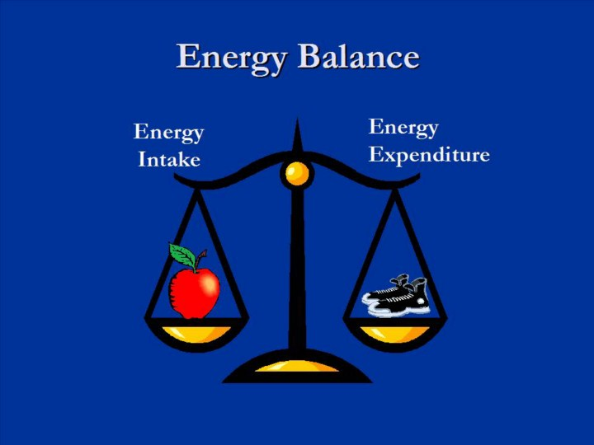
Obesity
A term used to describe people with a large fat content. (Usually over 30% or more body fat)
It is caused by an imbalance of calories consumed compared to energy expenditure.

Slide 16
How is it calculated?
BMI
(Body Mass Index)
It compares your weight to your height.

Slide 18
Ranges to know –
What is the problem with BMI scores?
Score | Result
Less than 20 | Underweight
20-25 | Correct weight
25-30 | Over weight
30+ | Obese

Slide 19
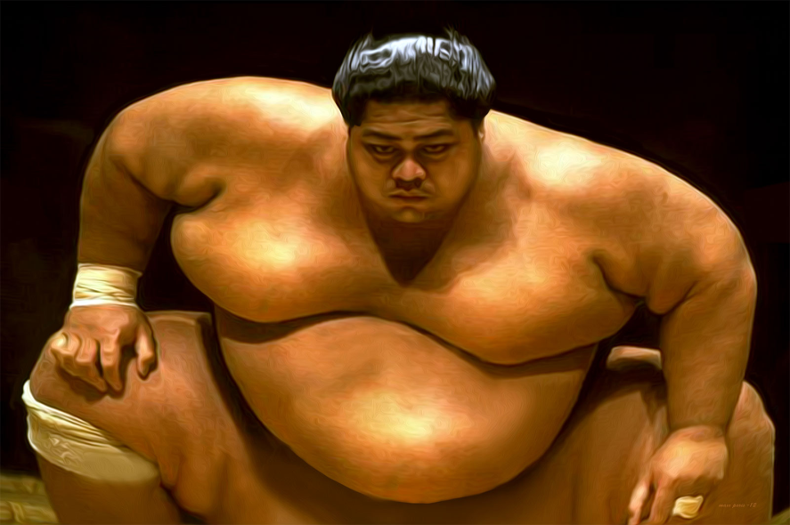
The effects of obesity on fitness
Limits CV fitness.
Making activity over time difficult.
Limits flexibility
Lacking full range of movement at joints when performing skills
Limits agility
Difficult to change direction quickly
Limits speed/power
Difficult to react quickly to produce force.

Slide 20
Effects on Health and well being.
Physical | Mental | Social
Development of cancer
Heart disease/attack
Hypertension
Diabetes
High cholesterol
High injury risk
Not enjoy being active

Slide 21
Effects on Health and well being.
Physical | Mental | Social
Development of cancer | Depression
Heart disease/attack | Loss of confidence
Hypertension | Cannot contribute to society
Diabetes
High cholesterol
High injury risk
Not enjoy being active

Slide 22
Effects on Health and well being.
Physical | Mental | Social
Development of cancer | Depression | Inability to socialise
Heart disease/attack | Loss of confidence | Unable to leave home
Hypertension | Cannot contribute to society | Uncomfortable in social situations due to how they feel about themselves
Diabetes
High cholesterol
High injury risk
Not enjoy being active

Slide 23
B
A
D

Slide 24
B
A
D
Blood pressure increases
Attacks of the heart
Diabetes

Slide 27
Somatotypes
Is a body type that may well mean you are well suited to a specific type of activity compared to others.
Can you think of any sports where you see a specific body type?
There are three categories of body type – these are all extremes

Slide 28
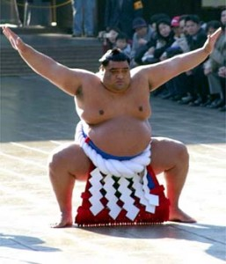
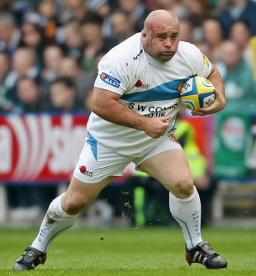
Endomorph
Pear shaped.
Wide at the hips with a tendency to gain fat, particularly on the upper arms and thighs..
Extreme ectomorphs will often struggle at which types of activity?
Weight bearing aerobic activity.
What sports could they be suited to?
Judo / Front row in rugby

Slide 29
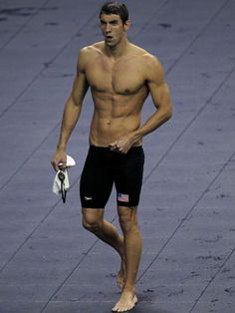
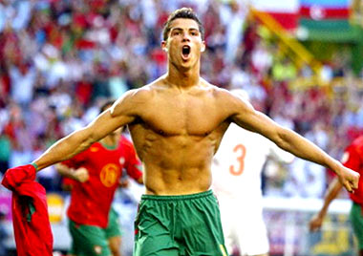
Mesomorph
Wedge shaped body.
Broad shoulders, muscled arms and legs, narrow hips and a minimum amount of fat.
Will often excel in strength, agility and speed activities.
With this body type almost all sports are achievable to play at a high level

Slide 30
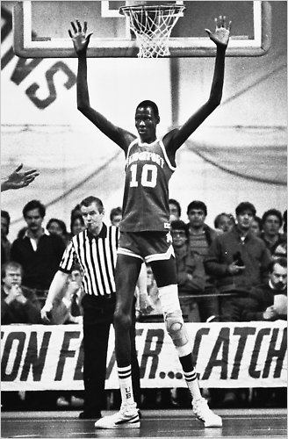
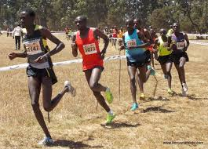
Ectomorph
Long, slender with narrow hips and shoulders.
Little muscle or body fat.
Due to their slight build, not well suited to power
and strength sports.
Well suited to endurance events such as marathon running.

Slide 31
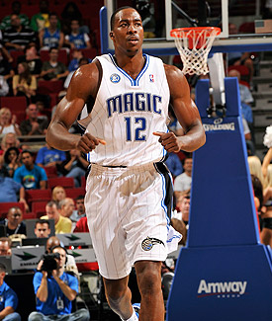
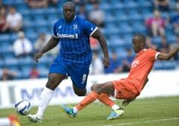
It is important to understand that no account of height is made in these classifications.
Most game players would not fit into any of these extremes.

Slide 32
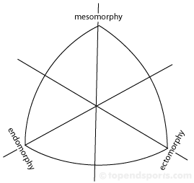
Weight lifter
High jumper
Tennis player

Slide 34
Exam question….
For the following sporting activity, suggest the stereotypical body shape that would suit that activity:
Activity | Somatotype
Hammer Thrower
Pole Vaulter
400m Sprinter
Marathon runner

Slide 35
Exam question….
For the following sporting activity, suggest the stereotypical body shape that would suit that activity:
Activity | Somatotype
Hammer Thrower | Endomorph
Pole Vaulter | Ectomorph
400m Sprinter | Mesomorph
Marathon runner | Ectomorph

Slide 36
Diet
K: The different components of a balanced diet
U: The nutrients in different food types
B: Explain the problems of an imbalanced diet

Slide 37
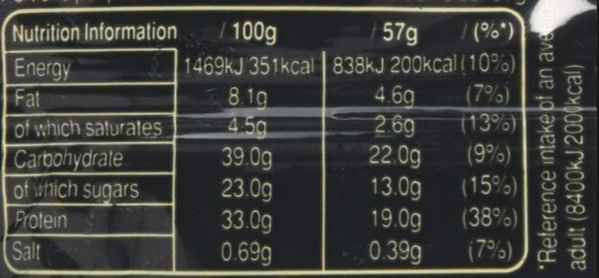
Daily requirements
How is energy measured?
Calories/Kilocalories

Slide 38
How many calories?
2000
2500

Slide 39
Several factors can effect the amount of calories an individual needs to consume:
Age (After 25 intake starts to fall)
Height
Energy expenditure
BMR (Basal metbolic rate) varies between individuals.
Your BMR (Basal Metabolic Rate) is an estimate of how many calories you'd burn if you were to do nothing but rest for 24 hours. It represents the minimum amount of energy needed to keep your body functioning, including breathing and keeping your heart beating.
If we do not use the calories that we take in, they will be stored in the body and cause weight gain.

Slide 40
Nutrients
What are nutrients?
The substances that make up food.
E.G –
Carbohydrates
Fats
Proteins
Vitamins
Minerals
Water
Fibre

Slide 41
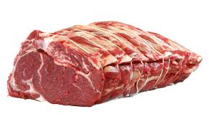
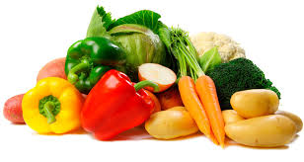
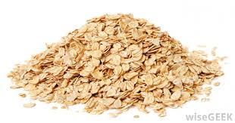
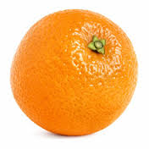
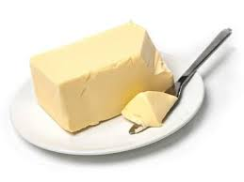

Slide 42
What does having a balanced diet mean?
Varying the food constituents.
Balancing the correct amount of calories.
Taking in sufficient nutrients (vitamins/minerals)
Five portions of fruit and veg per day (Fist sized)

Slide 43
What makes a balanced diet?

Slide 44
Why aim for a balance diet?
High fibre = prevents constipation + reduces cholesterol
Milk/cheese = provide calcium to help bones and teeth
Iron (mineral) = helps immune system and RBC production
Vitamin A (cheese) = helps skin and growth
Vitamin B (nuts/whole grain) = general body function
Vitamin C (Fruit) = helps liver and immune system
Vitamin D (Fish/eggs) = helps bones

Slide 45
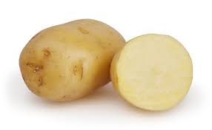
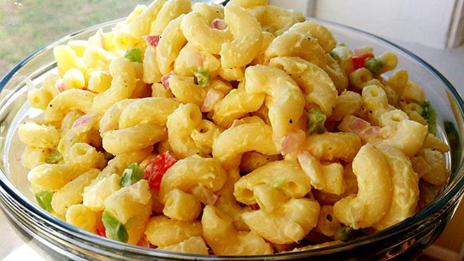
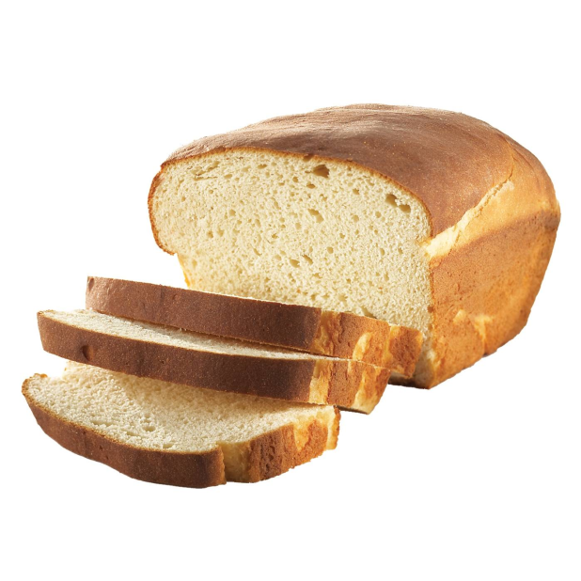
Carbohydrates
Simple = Glucose and sugars
Complex = Pasta, bread, potatoes.
Main energy source for active people.

Slide 46
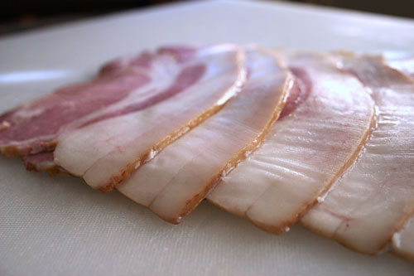
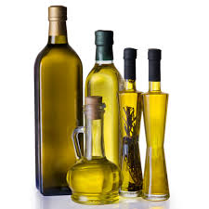
Fats
Fat is a major source of energy for the body – helps carry vitamins into the body.
Provides more energy that Carbs (over double) – however fat can only be used as an energy source at low intensity.
Saturated fat vs unsaturated
Your body needs 25-30% fat
High fat intake can lead to:
High cholesterol, heart disease, fatty deposits in arteries

Slide 47
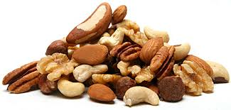
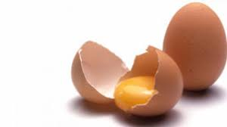
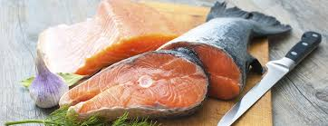
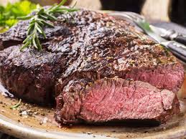
Protein
Vital in the growth in new tissue and muscle repair
The main sources:
Athletes that require a lot of
Strength and power will consume
a lot of protein.

Slide 48
Vitamins + minerals
Are essential to maintain good health. They are only required in small amounts, and are often found in a normal balanced diet.
They are mainly used to keep the body systems working efficiently and for general health.
Vitamin A = good for the skin
Calcium - bone health

Slide 49
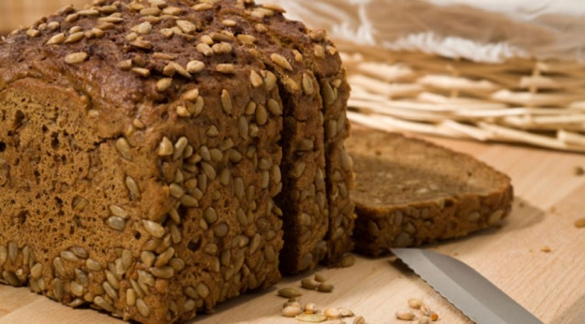
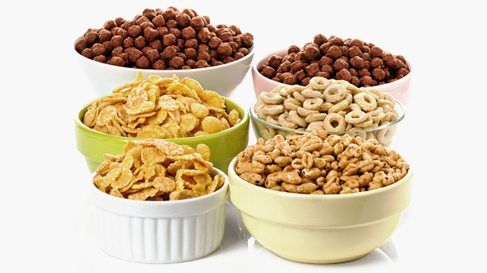
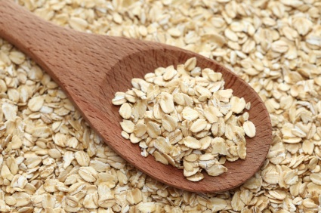
Fibre
Helps to aid the digestive system.
Mainly found in…..

Slide 50
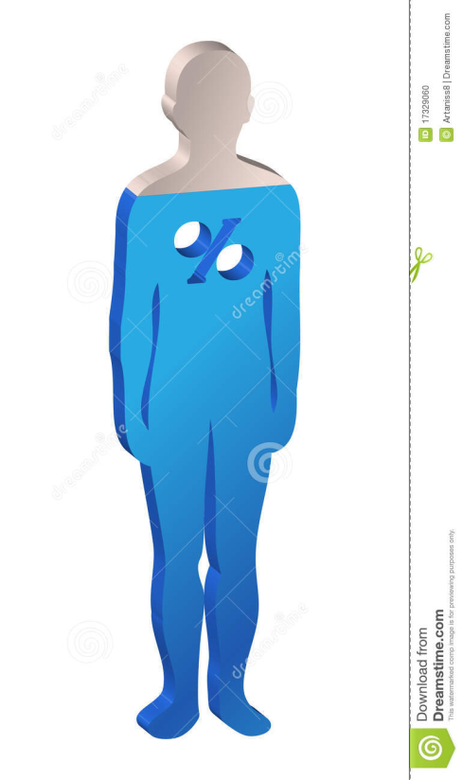
Water (hydration)
Essential to healthy living.
Over half the human body is water.
The recommended daily allowance is 8 large glasses of water.
What does dehydration lead to:
Increased viscosity of blood.
Increased heart rate
Increased body temperature
Reaction time decreases – affecting decision making
Fatigue and cramps.

Slide 51
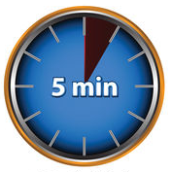
Exam question
Match the correct term with the correct definition:
Term | Definition
Dehydration | Consuming water to restore hydration
Hydration | Excessive loss of body water interrupting the function of the body
Rehydration | Having enough water (water balance) to enable normal functioning of the body

Slide 52
Exam question
Match the correct term with the correct definition:
Term | Definition
Dehydration | Excessive loss of body water interrupting the function of the body
Hydration | Having enough water (water balance) to enable normal functioning of the body
Rehydration | Consuming water to restore hydration

