Slide 1
Health Profile in Blackpool
This profile gives a picture of people’s health in Blackpool. It is designed to help local government and health services understand their community’s needs, so that they can work together to improve people’s health and reduce health inequalities
THE STATISTICS
Life Expectancy
MALE
74.2 YRS
FEMALE
749.5 YRS
Significantly worse than England average
In Y6, 21.2% (291) of children are classified as obese in Blackpool
Levels of teenage pregnancy are worse than the average in England
Hospital stays for self harm were 578.9 in Blackpool V 185.3 on average in England
Sexually transmitted infections are significantly worse in Blackpool than England’s average
Estimated levels of adult smoking are worse than the average for Blackpool
The rate of alcohol-specific hospital stays is worse than the average for England
Notes:
In today's assembly we are going to focus on what contributes to leading a healthy lifestyle. On this slide we will present an overview of the health profile in Blackpool.

Slide 2
What is Health?
Health is a complete state of physical, mental and social well-being not merely the absence of disease or infirmity.
Physical
Mental
Social
All body systems working well, free from illness and injury. Ability to carry out everyday tasks
A state of well-being in which every individual realises her/his own potential, can cope with the stresses of life, can work productively and fruitfully, and is able to make a contribution to her/his community
Basic human needs are being met. The individual has friendships and support, some value in society, is socially active and has little stress in social circumstances

Slide 3
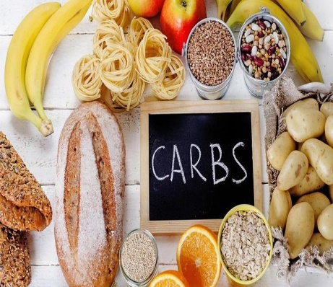
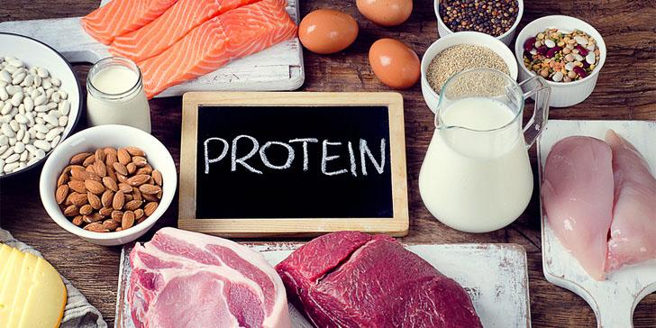
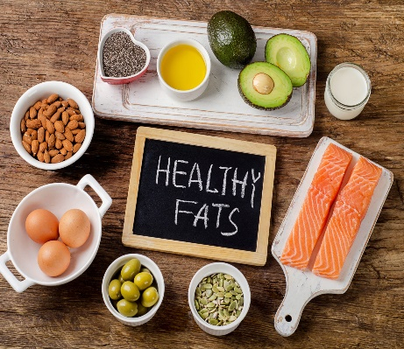
Physical Health - Obesity
This is a term used to describe people with a large fat content, caused by an imbalance of calories consumed to energy expenditure
Calorie
They are obtained from the food and drink we consume. Therefore, the more calories we eat through our food the more energy we have to use
2000
What do you think these numbers mean?
The average adult male requires 2500kcal/day whilst the average female requires 2000kcal/day
2500
55-60%
15-20%
25-30%

Slide 4
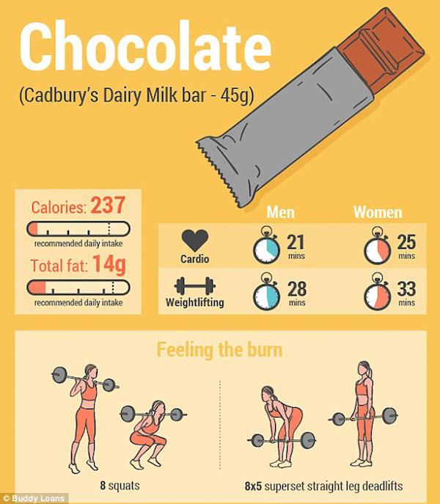
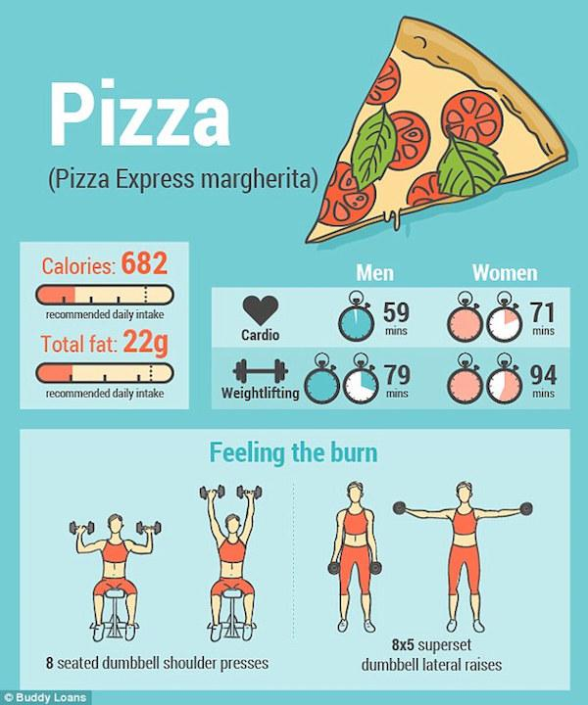
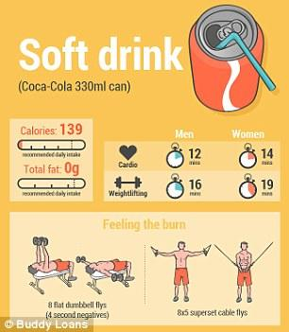
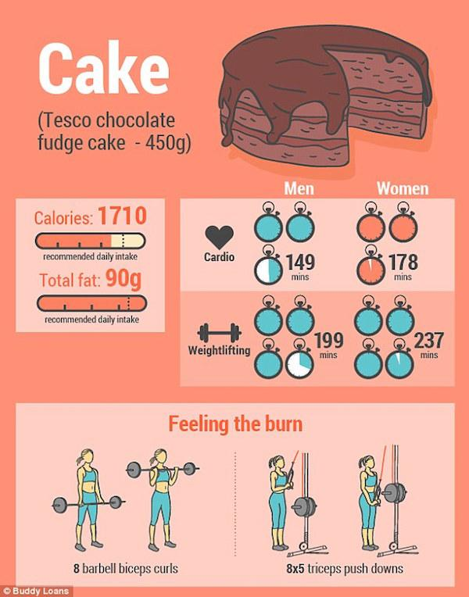
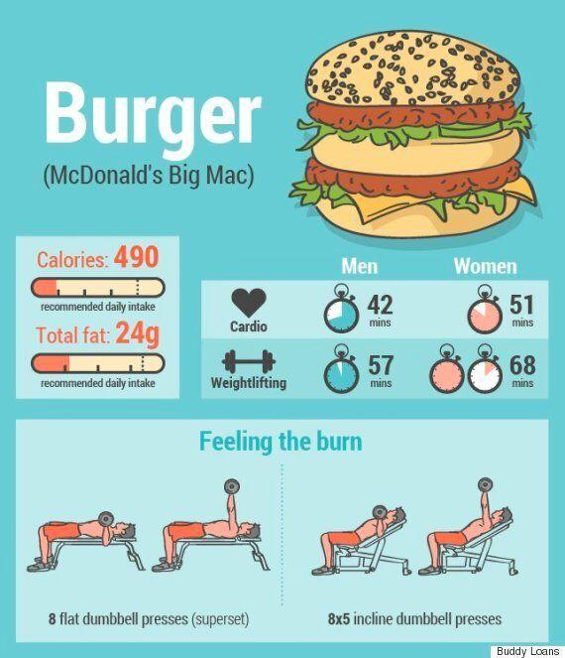
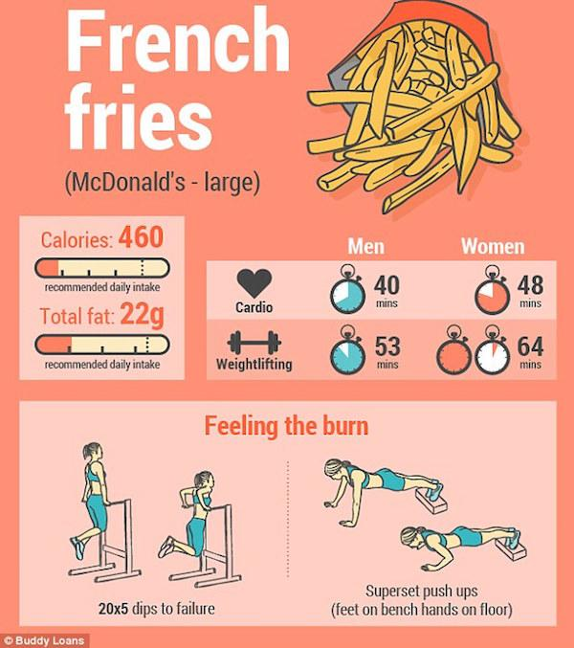
Notes:
Speaker to go through each food example and the amount of calories V exercise needed to burn off the particular food consumed.

Slide 5
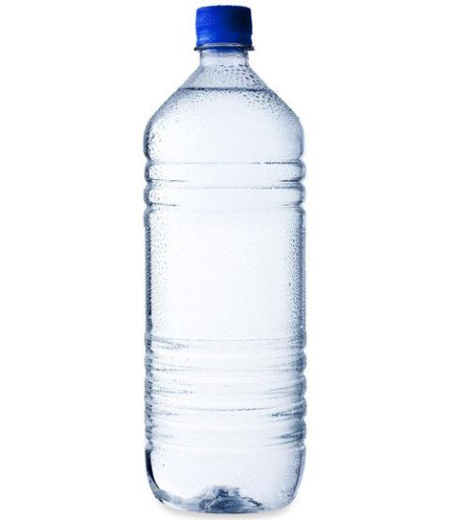
Physical Health - Hydration
Having enough water to enable normal functioning of the body
8
x
Why do we need water…
Dehydration
-It makes up more than half of the human body
-It is necessary to maintain hydration levels
-It helps with reactions and maintaining correct body temperatures
-Hotter you are the more you sweat, therefore you need to replenish
-The blood thickens (viscosity)
-Heart rate increases, which means the heart has to work harder
-The body might overheat
-Reactions will become slower
-Muscle fatigue/muscle cramps
Notes:
11-16 year olds should be drinking on average 2ltrs of water a day, which is 8 bottles you can purchase in the canteen

Slide 6
Mental Health
We all have mental health just as we all have physical and social health. Mental health problems can affect anyone no matter what your life is.
Mental health includes our emotional, psychological and social well-being. It can affect how we think, feel and act.
Positive mental health allows people to develop, learn and cope with the stresses of life.
1 in 10 young people will experience a mental health problem. That is 3 in every classroom
70% of young people who have experienced a mental health problem say they’ve had negative reactions from their friends
Depression, anxiety and eating disorders are examples of the most common mental health problems in society
Notes:
MENTAL HEALTH HEADING click for the link to video

Slide 7
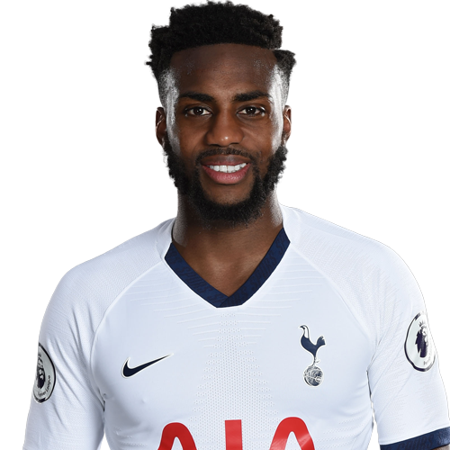
Danny Rose
BBC SPORT
Notes:
DANNY ROSE HEADING click for link

Slide 8
Mental Health
8 Ways to Self Well-Being
Talking
Be open with people you trust about how you’re feeling
Exercise
Look after your body by playing sport and eating healthily
Calming
Have good sleeping patterns by turning your phone off early
Learning
Learn a new skill, a great way to gain confidence and stimulate the brain
Relating
Spend time with people you care about
Contributing
Help others or contribute to causes you believe in
Creating
Express yourself creatively, e.g. music, art, drama or writing
Congratulating
Be kind to yourself, or listing the qualities you value in yourself

Slide 9
Mental Health – Ask Twice
You don’t have to be an expert, just be a friend
1. Listen
2. Wanna hang out?
3. Saw this and thought of you
4. I care about you
5. That sounds really difficult
6. ASK TWICE
Notes:
MENTAL HEALTH - ASK TWICE Heading click to link

Slide 10
Instagram
Podcasts
Websites
@celestebarber
@bodyposipanda
@mypaleskinblog
@chessiekingg
@saggysara
@sonnyturner
@hi_ur_beautiful
@theeverymanproject
@bopo.boy
@love_disfigure
The School of Greatness
This American Life
Aim a Little Higher
Stuff You Should know
Scroobius Pip’s Distraction Pieces
TED Talks Podcasts
The Daily Boost
How To Do Everything
Tough Girl Podcast
Answer Me This
www.timetochange.org.uk
www.nhs.co.uk
www.youngminds.org.uk
www.mind.org.uk
www.headstart.org.uk
Books
Chicken Soup for the Teenage Soul
You Are A Badass
My Anxious Mind
You Don’t Have To Learn Everything The Hard Way
7 Habits Of Highly Effective Teenagers
Think Positive
Notes:
THINK POSITIVE HEADING click for link

