Slide 1
BTEC Sport
Unit 2: Fitness Training and Programming for Health, Sport and Well-being.

Slide 2
B Understand the screening processes for training programming
B1 Screening Processes
Be able to interpret the lifestyle of a selected individual using appropriate screening documentation, and know when to refer the individual to a doctor.
• Screening questionnaires: Lifestyle questionnaires, physical activity readiness questionnaires (PAR-Q).
• Legal considerations: Informed consent form, data protection, client confidentiality.

Slide 3
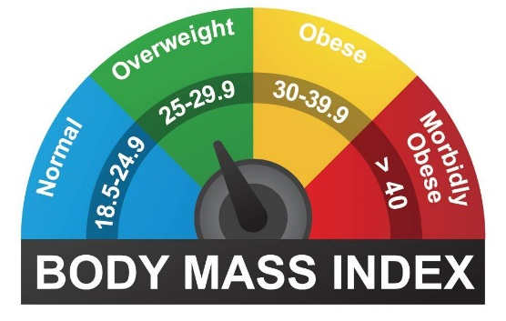
B Understand the screening processes for training programming
B2 Health monitoring tests
Be able to interpret health monitoring results of a selected individual using normative data and make appropriate recommendations.
• Blood pressure.
• Resting heart rate.
• Body mass index (BMI).
• Waist to hip ratio.
B3 Interpreting the results of health monitoring tests
Be able to interpret health monitoring data against health norms and make judgements.
• Interpret results against normative data: compare and make judgements against population norms, norms for sports performers, norms for elite athletes, accepted health ranges.

Slide 4
B1 Screening Processes
Lifestyle questionnaires.
When designing a training programme, you need to know about the client’s lifestyle factors which will influence how you plan the programme.
Write down a list of questions you would ask a client to get a full picture of their lifestyle.

Slide 5
PAR-Q

Slide 7
Legal Requirements

Slide 8
B2 Health monitoring tests
Be able to interpret health monitoring results of a selected individual using normative data and make appropriate recommendations.
Blood pressure.
Resting heart rate.
Body mass index (BMI).
Waist to hip ratio.

Slide 9
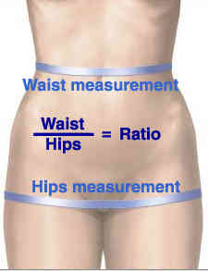
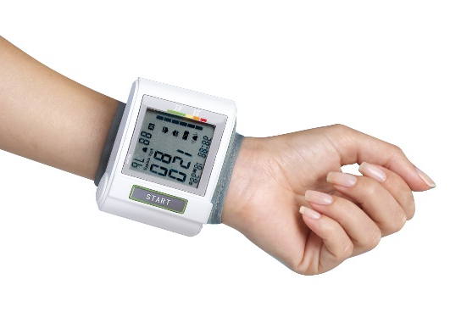

Slide 11
B3 Interpreting the results of health monitoring tests
Be able to interpret health monitoring data against health norms and make judgements.
Interpret results against normative data: compare and make judgements against population norms, norms for sports performers, norms for elite athletes, accepted health ranges.

Slide 14
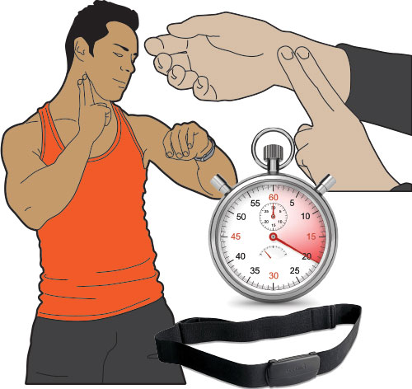

Slide 15
Normative Data Resting Heart Rate

Slide 16
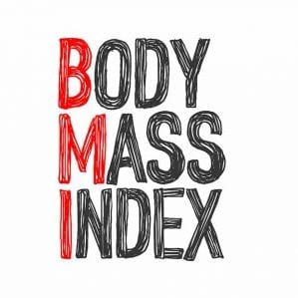

Slide 17
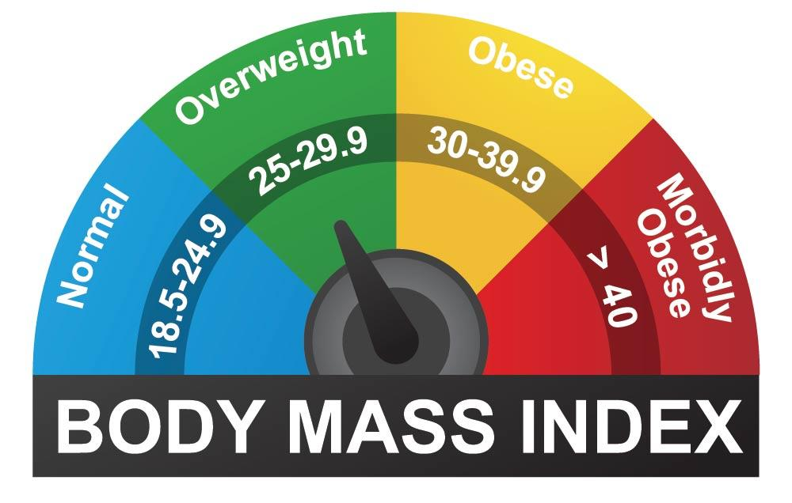

Slide 18
